Slide 1
COMP 2230
Week 11 - Friday

Slide 2
Last time
Algorithm efficiency

Slide 3
Questions?

Slide 4
Assignment 5

Slide 5
Back to Insertion Sort Analysis

Slide 6
Insertion sort in code
public static void sort( int[] array, int n) {
for (int i = 1; i < n; ++i) {
int next = array[i];
int j = i - 1;
while (j != 0 && array[j] > next) {
array[j+1] = array[j];
--j;
}
array[j] = next;
}
}

Slide 7
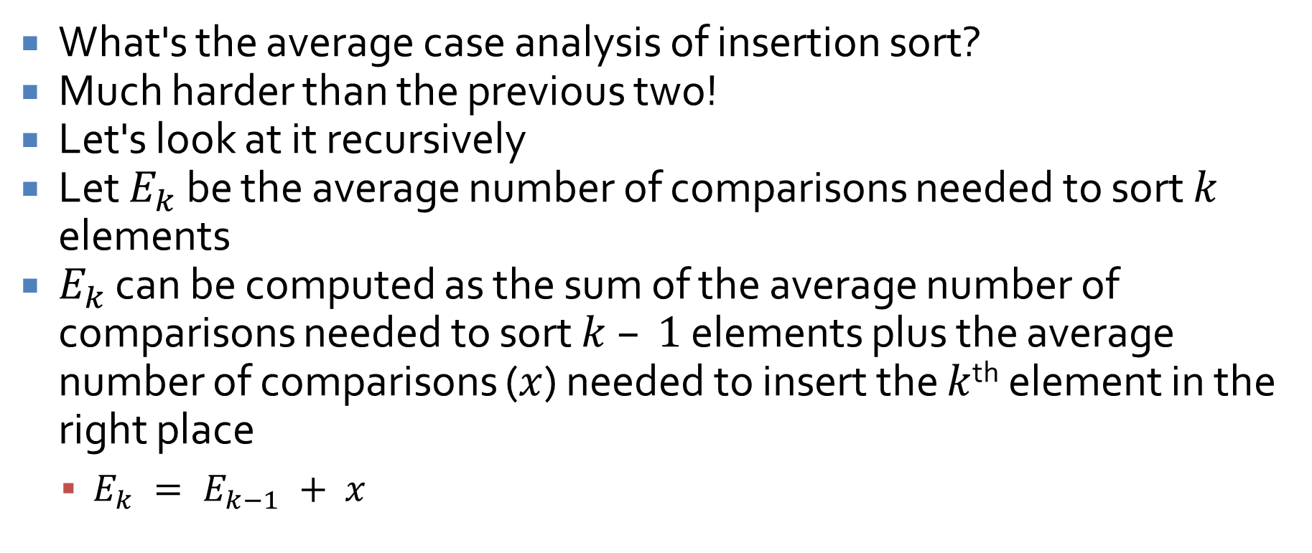
Average case analysis of insertion sort
What's the average case analysis of insertion sort?
Much harder than the previous two!
Let's look at it recursively
Let $E_{k}$ be the average number of comparisons needed to sort $k$ elements
$E_{k}$ can be computed as the sum of the average number of comparisons needed to sort $k – 1$ elements plus the average number of comparisons ($x$) needed to insert the $k$^{th} element in the right place
  $E_{k} = E_{k−1} + x$

Slide 8
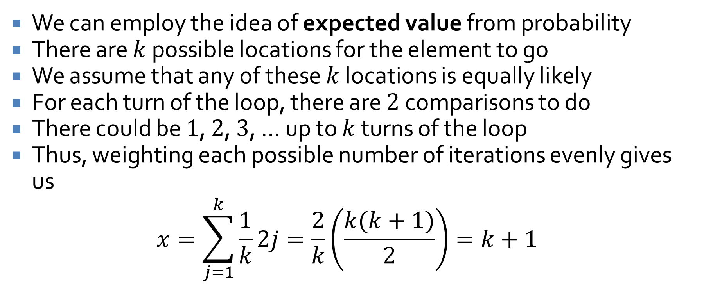

Finding $x$
We can employ the idea of expected value from probability
There are $k$ possible locations for the element to go
We assume that any of these $k$ locations is equally likely
For each turn of the loop, there are $2$ comparisons to do
There could be $1$, $2$, $3$, … up to $k$ turns of the loop
Thus, weighting each possible number of iterations evenly gives us
$$x=\sum_{j=1}^{k}{\frac{1}{k}2j=\frac{2}{k}\left(\frac{k(k+1)}{2}\right)}=k+1$$

Slide 9
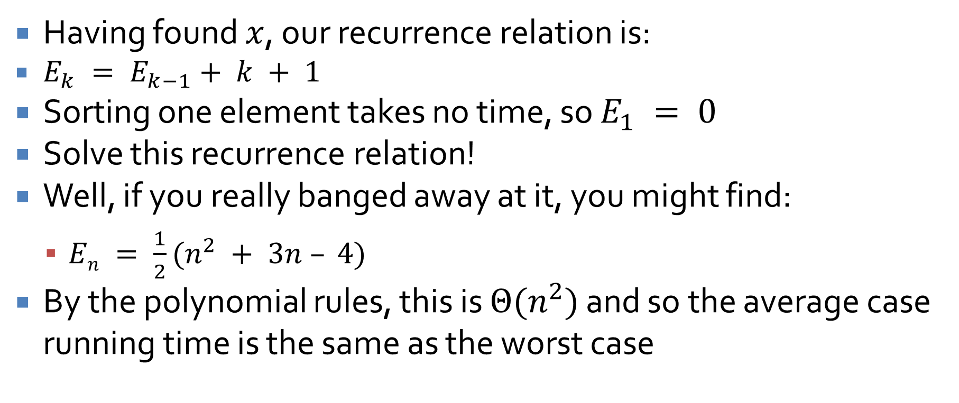
Finishing the analysis
Having found $x$, our recurrence relation is:
  $E_{k} = E_{k−1}+ k + 1$
Sorting one element takes no time, so $E_{1} = 0$
Solve this recurrence relation!
Well, if you really banged away at it, you might find:
  $En = \frac{1}{2}(n^{2} + 3n – 4)$
By the polynomial rules, this is $Θ(n^{2})$ and so the average case running time is the same as the worst case

Slide 10
Exponential and Logarithmic Functions

Slide 11
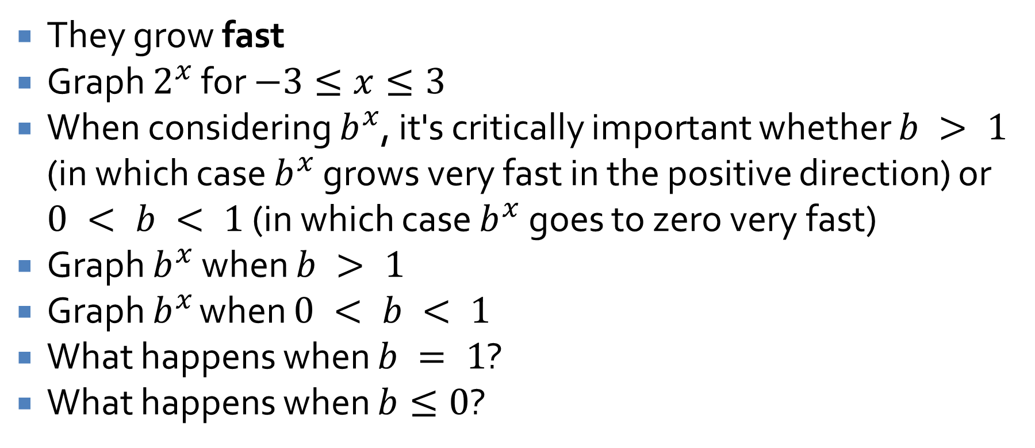
Exponential functions
They grow fast
Graph $2^{x}$ for $−3≤x≤3$
When considering $b^{x}$, it's critically important whether $b > 1$ (in which case $b^{x}$ grows very fast in the positive direction) or $0 < b < 1$ (in which case $b^{x}$ goes to zero very fast)
Graph $b^{x}$ when $b > 1$
Graph $b^{x}$ when $0 < b < 1$
What happens when $b = 1$?
What happens when $b≤0$?

Slide 12
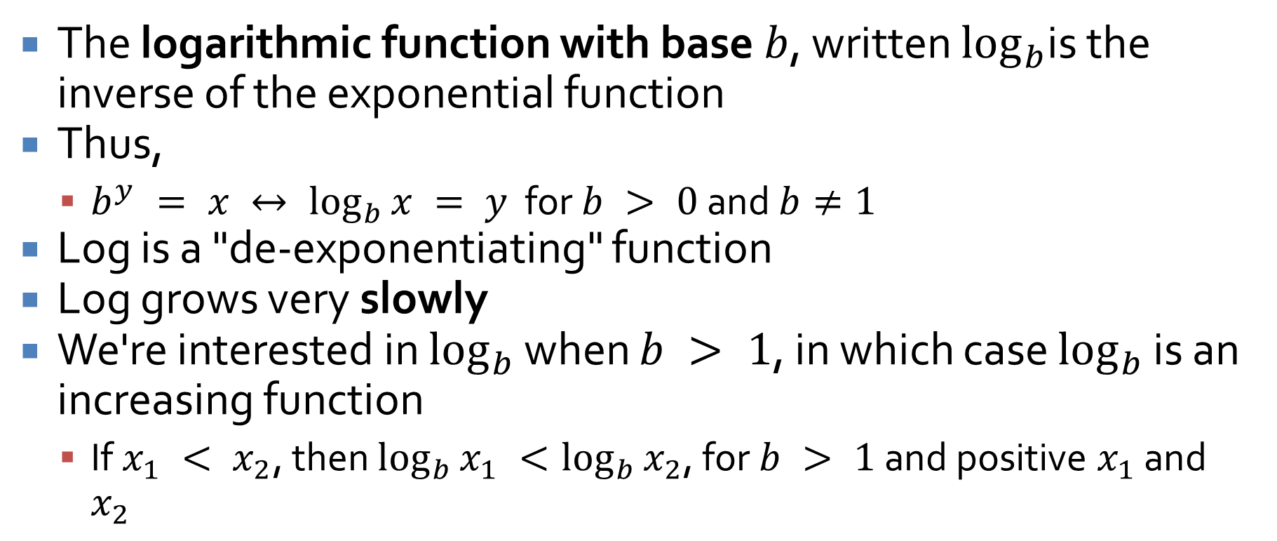
Logarithmic function
The logarithmic function with base $b$, written $log_{b}$is the inverse of the exponential function
Thus,
  $b^{y} = x ↔ \log_{b}{x} = y$ for $b > 0$ and $b≠1$
Log is a "de-exponentiating" function
Log grows very slowly
We're interested in $log_{b}$ when $b > 1$, in which case $log_{b}$ is an increasing function
  If $x_{1} < x_{2}$, then $\log_{b}{x_{1}} <\log_{b}{x_{2}}$, for $b > 1$ and positive $x_{1}$ and $x_{2}$

Slide 13
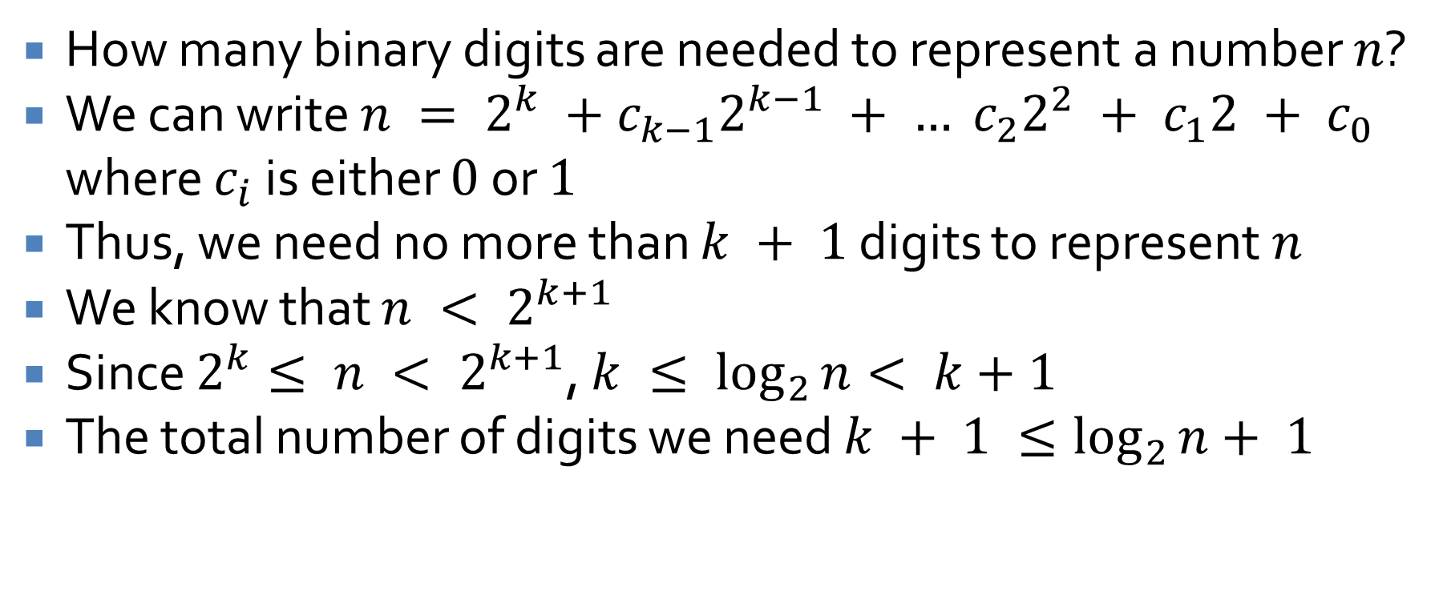

Applying $log⁡$
How many binary digits are needed to represent a number $n$?
We can write $n = 2^{k} +c_{k−1}2^{k−1} + … c_{2}2^{2} + c_{1}2 + c_{0}$ where $c_{i}$ is either $0$ or $1$
Thus, we need no more than $k + 1$ digits to represent $n$
We know that $n < 2^{k+1}$
Since $2^{k}≤ n < 2^{k+1}$, $k ≤ \log_{2}{n}< k+1$
The total number of digits we need $k + 1 ≤\log_{2}{n}+ 1$

Slide 14
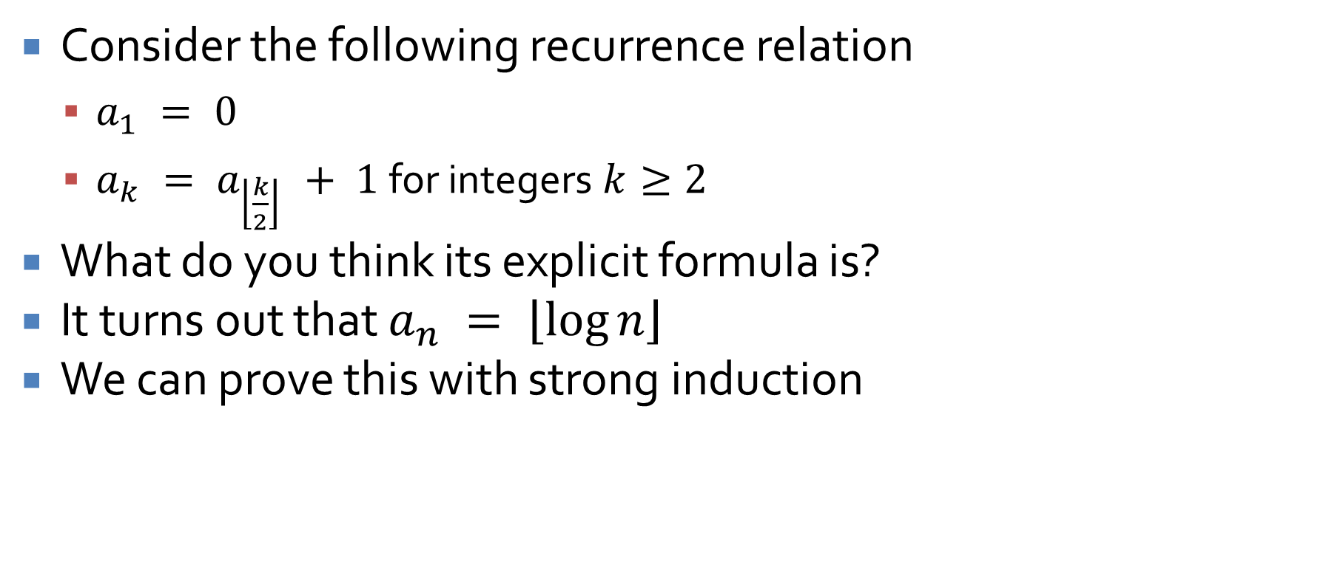
Recurrence relations
Consider the following recurrence relation
  $a_{1} = 0$
  $a_{k} = a_{\left\lfloor \frac{k}{2}\right\rfloor } + 1$ for integers $k≥2$
What do you think its explicit formula is?
It turns out that $a_{n} = \left\lfloor \log{n}\right\rfloor$
We can prove this with strong induction

Slide 15
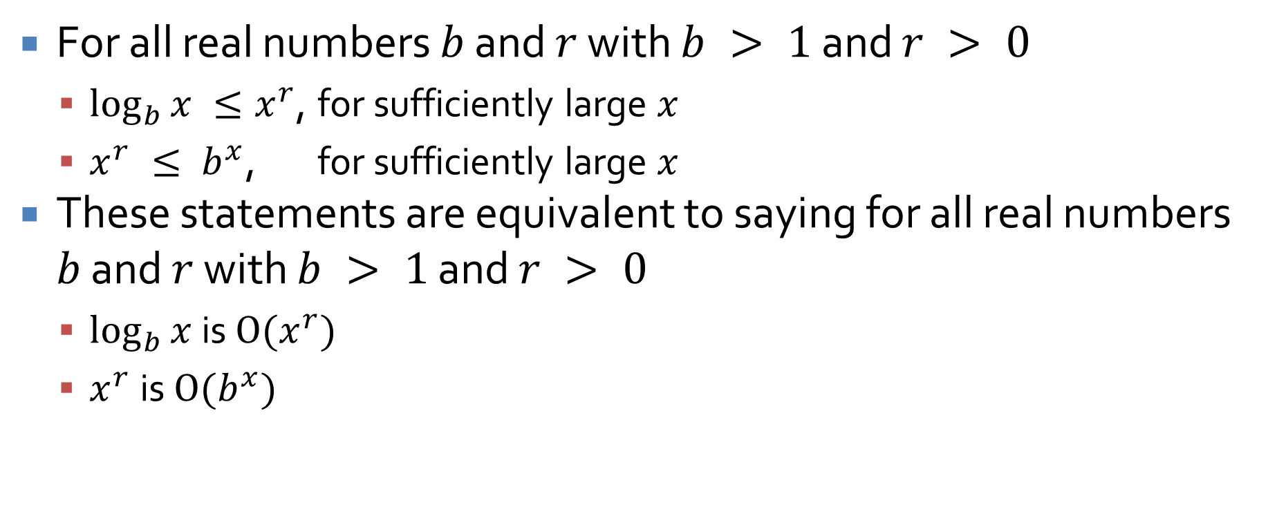
Exponential and logarithmic orders
For all real numbers $b$ and $r$ with $b > 1$ and $r > 0$
  $\log_{b}{x} ≤x^{r}$, for sufficiently large $x$
  $x^{r} ≤ b^{x}$, for sufficiently large $x$
These statements are equivalent to saying for all real numbers $b$ and $r$ with $b > 1$ and $r > 0$
  $\log_{b}{x}$ is $O(x^{r})$
  $x^{r}$is $O(b^{x})$

Slide 16
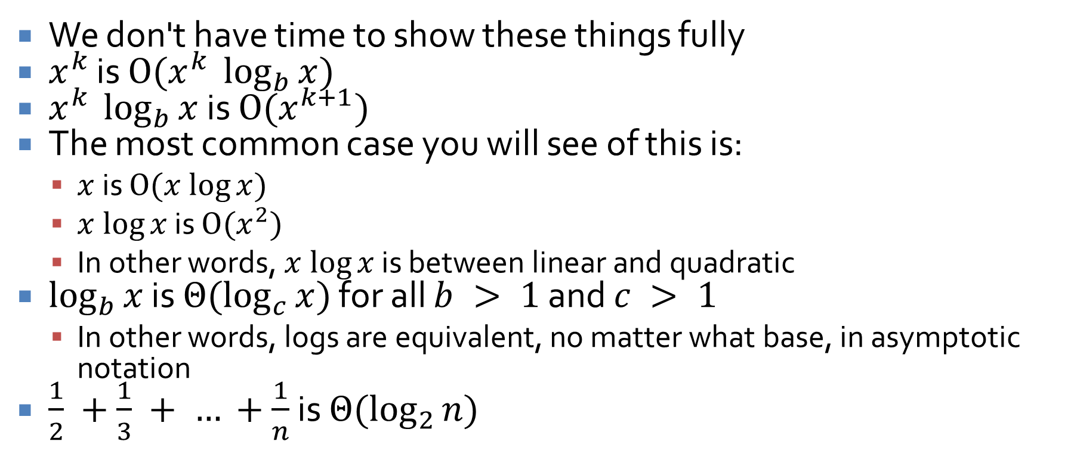
Important things
We don't have time to show these things fully
$x^{k}$ is $O(x^{k} \log_{b}{x})$
$x^{k} \log_{b}{x}$ is $O(x^{k+1})$
The most common case you will see of this is:
  $x$ is $O(x log⁡x)$
  $x log⁡x$ is $O(x^{2})$
  In other words, $x log⁡x$ is between linear and quadratic
$\log_{b}{x}$ is $Θ(\log_{c}{x})$ for all $b > 1$ and $c > 1$
  In other words, logs are equivalent, no matter what base, in asymptotic notation
$\frac{1}{2} +\frac{1}{3} + … +\frac{1}{n}$ is $Θ(\log_{2}{n})$

Slide 17
Review

Slide 18
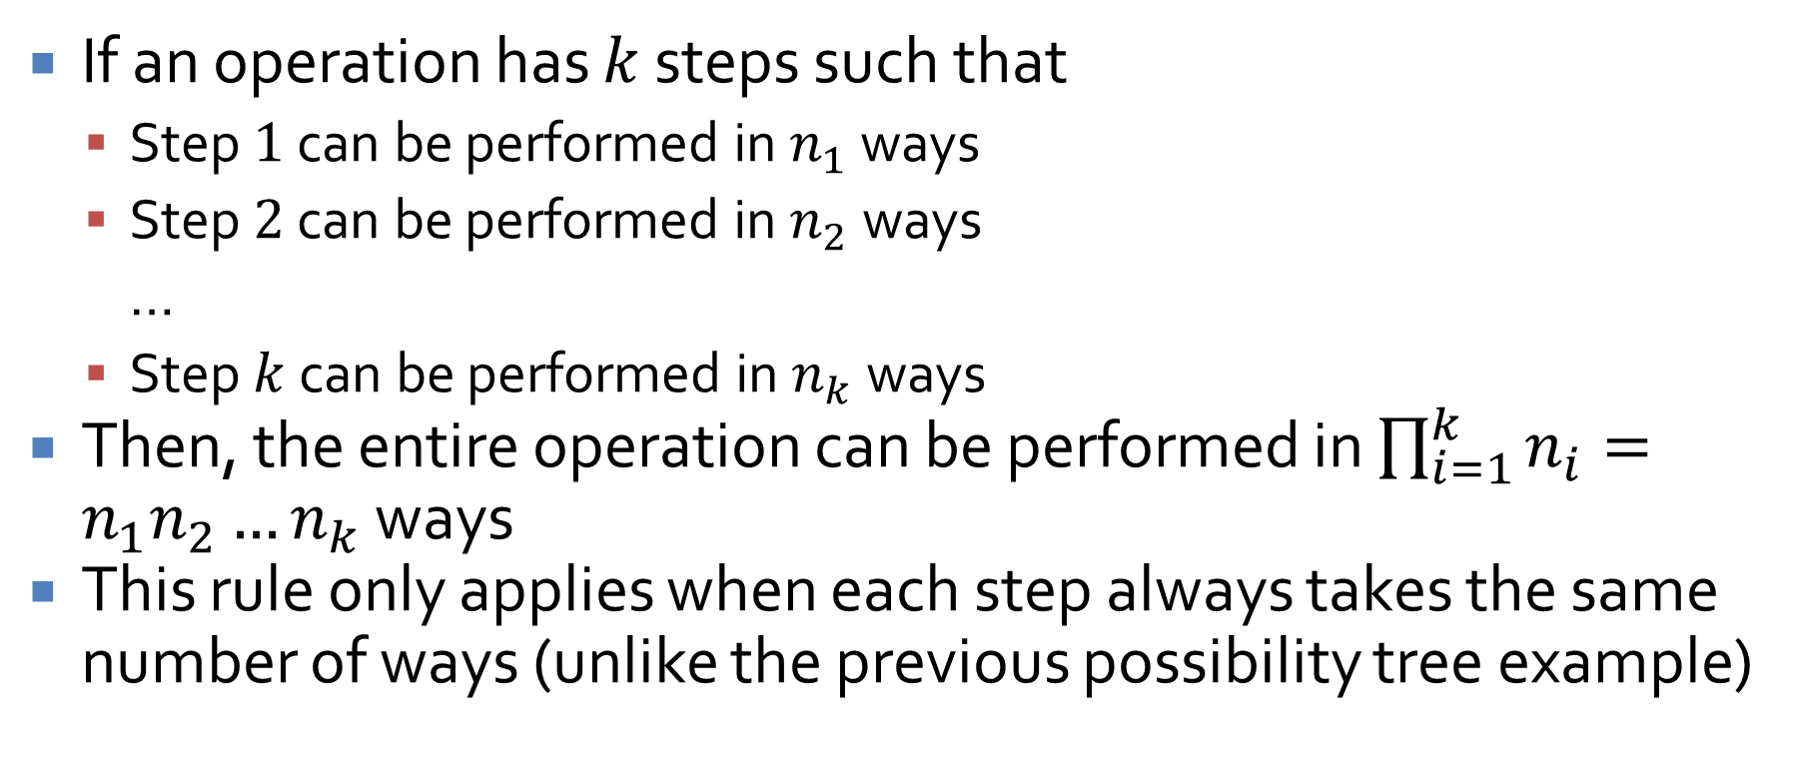
Multiplication rule
If an operation has $k$ steps such that
  Step $1$ can be performed in $n_{1}$ ways
  Step $2$ can be performed in $n_{2}$ ways
  …
  Step $k$ can be performed in $n_{k}$ ways
Then, the entire operation can be performed in $\prod_{i=1}^{k}{n_{i}}=n_{1}n_{2}…n_{k}$ ways
This rule only applies when each step always takes the same number of ways (unlike the previous possibility tree example)

Slide 19
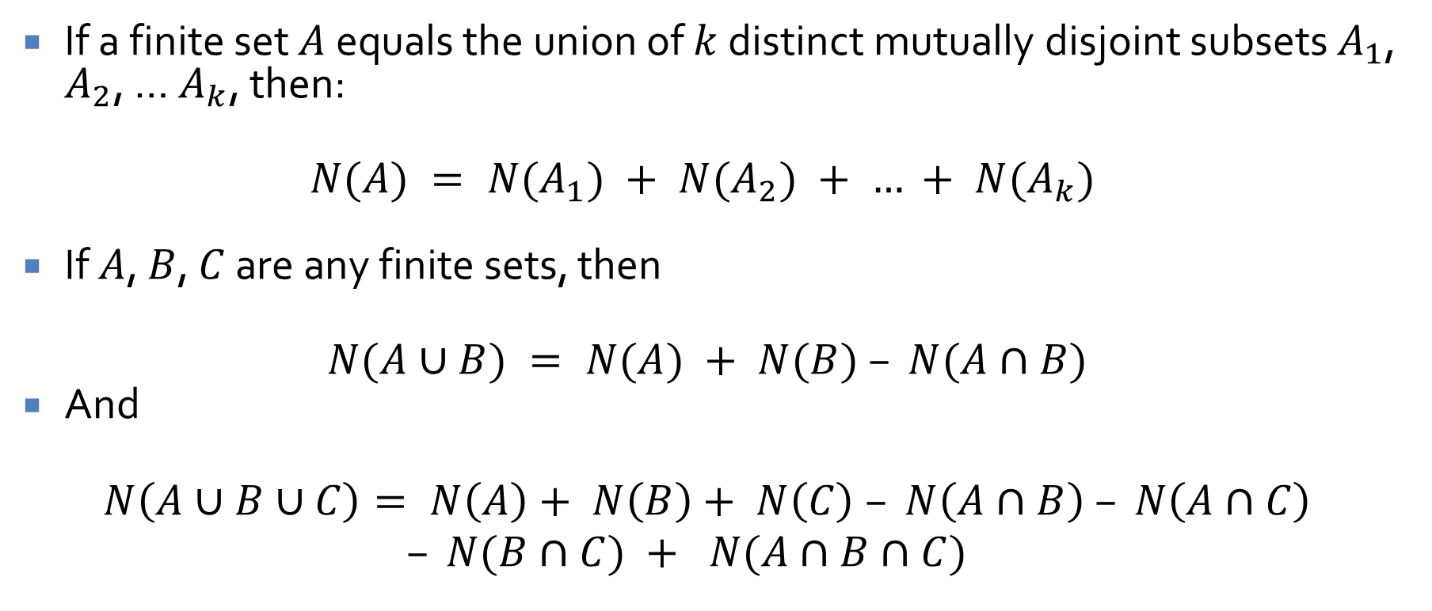
Addition and inclusion/exclusion rules
If a finite set $A$ equals the union of $k$ distinct mutually disjoint subsets $A_{1}$, $A_{2}$, … $A_{k}$, then:
$$N(A) = N(A_{1}) + N(A_{2}) + … + N(A_{k})$$
If $A$, $B$, $C$ are any finite sets, then
$$N(A∪B) = N(A) + N(B) – N(A∩B)$$
And
$$N\left(A∪B∪C\right)= N\left(A\right)+ N\left(B\right)+ N\left(C\right) – N\left(A∩B\right) – N\left(A∩C\right)$$
$$– N(B∩C) + N(A∩B∩C)$$

Slide 20
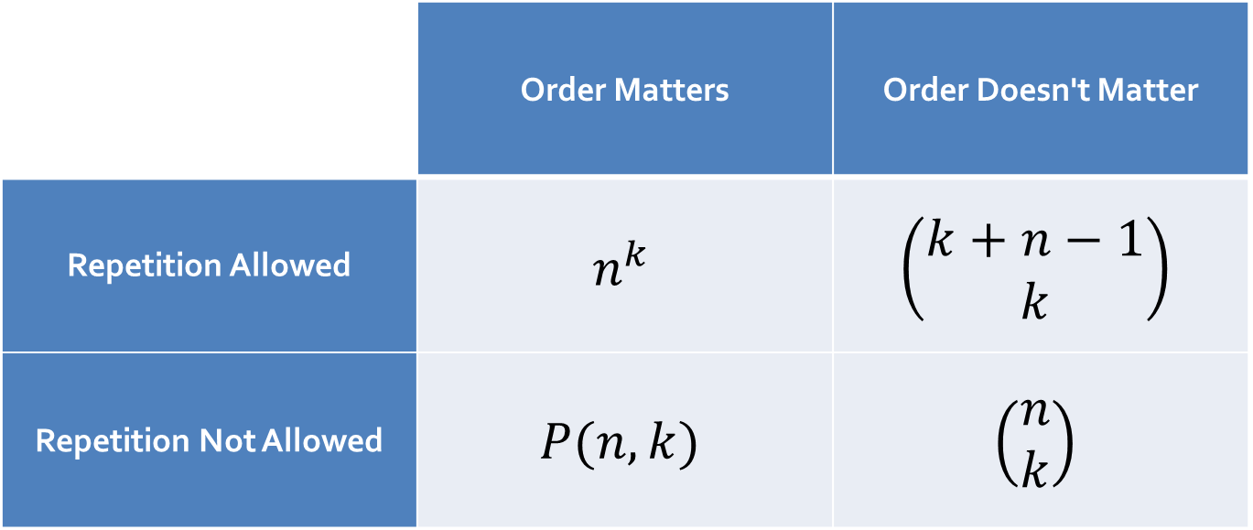
Handy dandy guide to counting
This is a quick reminder of all the different ways you can count things:
 | Order Matters | Order Doesn't Matter
Repetition Allowed | $$n^{k}$$ | $$\left(\begin{matrix}k+n−1 \\ k\end{matrix}\right)$$
Repetition Not Allowed | $$P(n,k)$$ | $$\left(\begin{matrix}n \\ k\end{matrix}\right)$$

Slide 21
How many ways are there to…
Order the letters in the word "replicant"
Order any three letters in the word "replicant"?
Order the letters in the word "neverness"
  If all letters are considered distinct?
  If identical letters cannot be told apart?
Select an elite assassin team of 8 people from a squadron of 100?
Select an elite assassin team of 8 people from a squadron of 100 and make one person the leader?

Slide 22
How many ways are there to…
Name a child if you're willing use any sequence of characters from the Latin alphabet from 1 to 10 characters long?
Decide the five courses you'd like to take in a semester, if the kinds are:
  Computer Science courses
  INST courses
  Electives

Slide 23
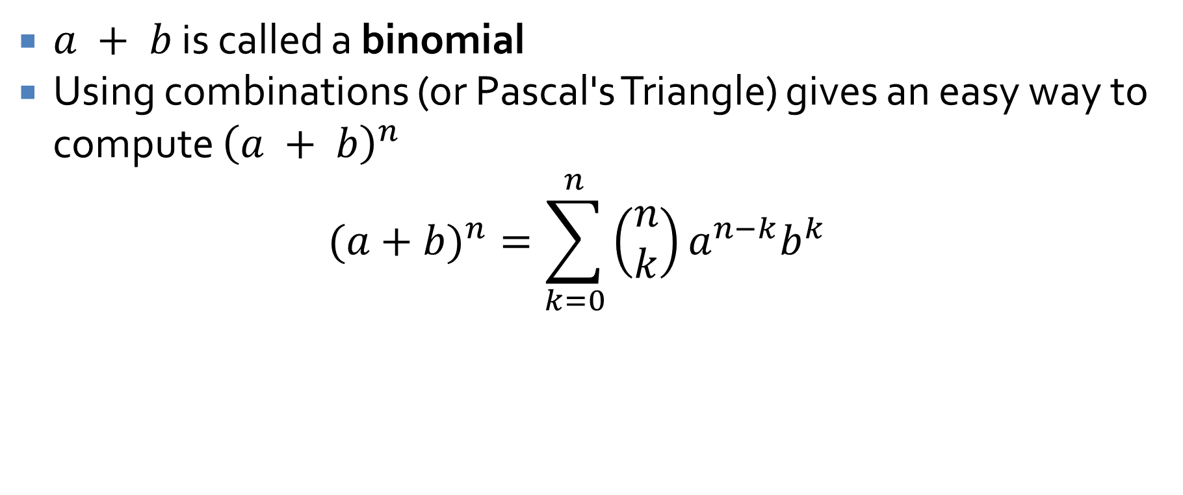
Binomial theorem
$a + b$ is called a binomial
Using combinations (or Pascal's Triangle) gives an easy way to compute ${\left(a + b\right)}^{n}$
$$(a+b)^{n}=\sum_{k=0}^{n}{\left(\begin{matrix}n \\ k\end{matrix}\right)}a^{n−k}b^{k}$$

Slide 24
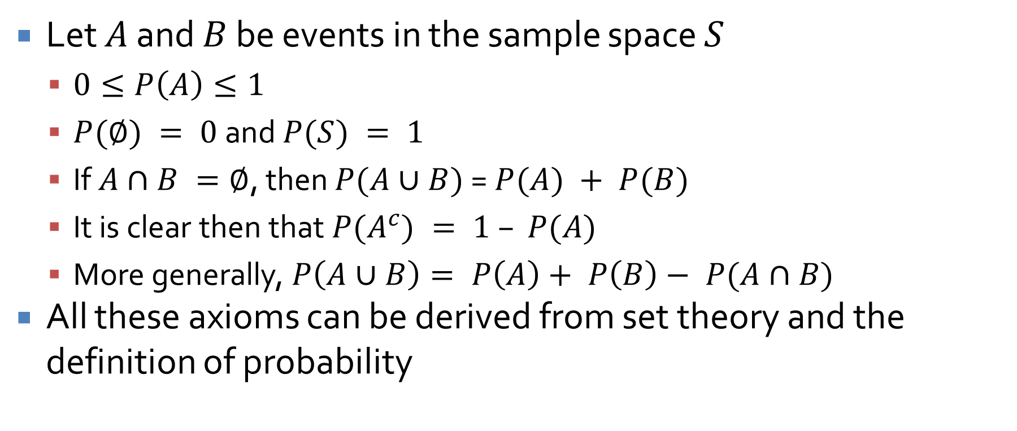
Probability axioms
Let $A$ and $B$ be events in the sample space $S$
  $0≤P\left(A\right)≤1$
  $P(∅) = 0$ and $P(S) = 1$
  If $A∩B =∅$, then $P(A∪B)$ = $P(A) + P(B)$
  It is clear then that $P(A^{c}) = 1 – P(A)$
  More generally, $P\left(A∪B\right)= P\left(A\right)+ P\left(B\right)− P(A∩B)$
All these axioms can be derived from set theory and the definition of probability

Slide 25
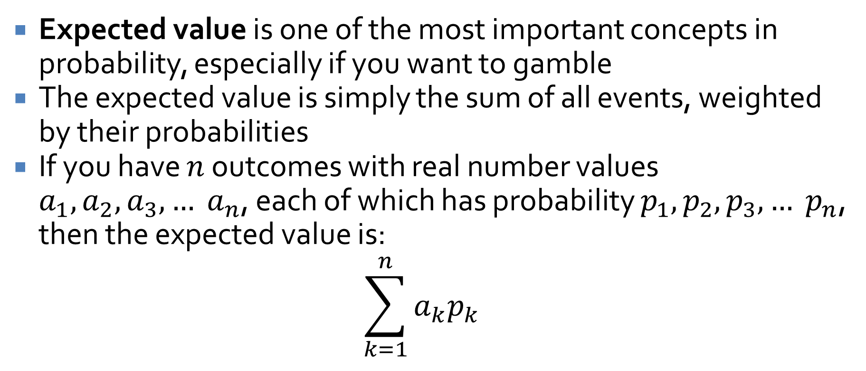
Expected value
Expected value is one of the most important concepts in probability, especially if you want to gamble
The expected value is simply the sum of all events, weighted by their probabilities
If you have $n$ outcomes with real number values $a_{1}, a_{2}, a_{3},… a_{n}$, each of which has probability $p_{1}, p_{2}, p_{3},… p_{n}$, then the expected value is:
$$\sum_{k=1}^{n}{a_{k}p_{k}}$$

Slide 26
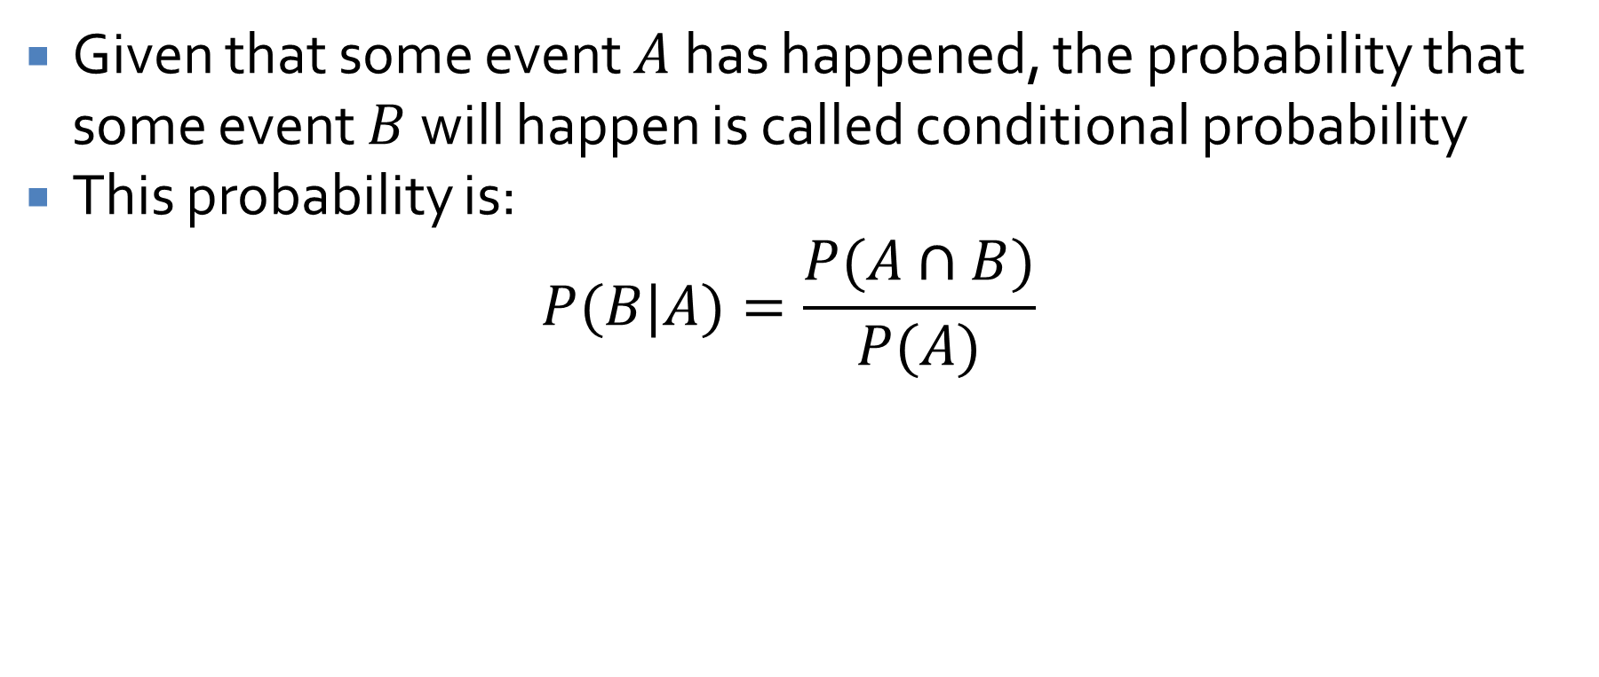
Conditional probability
Given that some event $A$ has happened, the probability that some event $B$ will happen is called conditional probability
This probability is:
$$P(B|A)=\frac{P(A∩B)}{P(A)}$$

Slide 27
Graphs and Trees

Slide 28
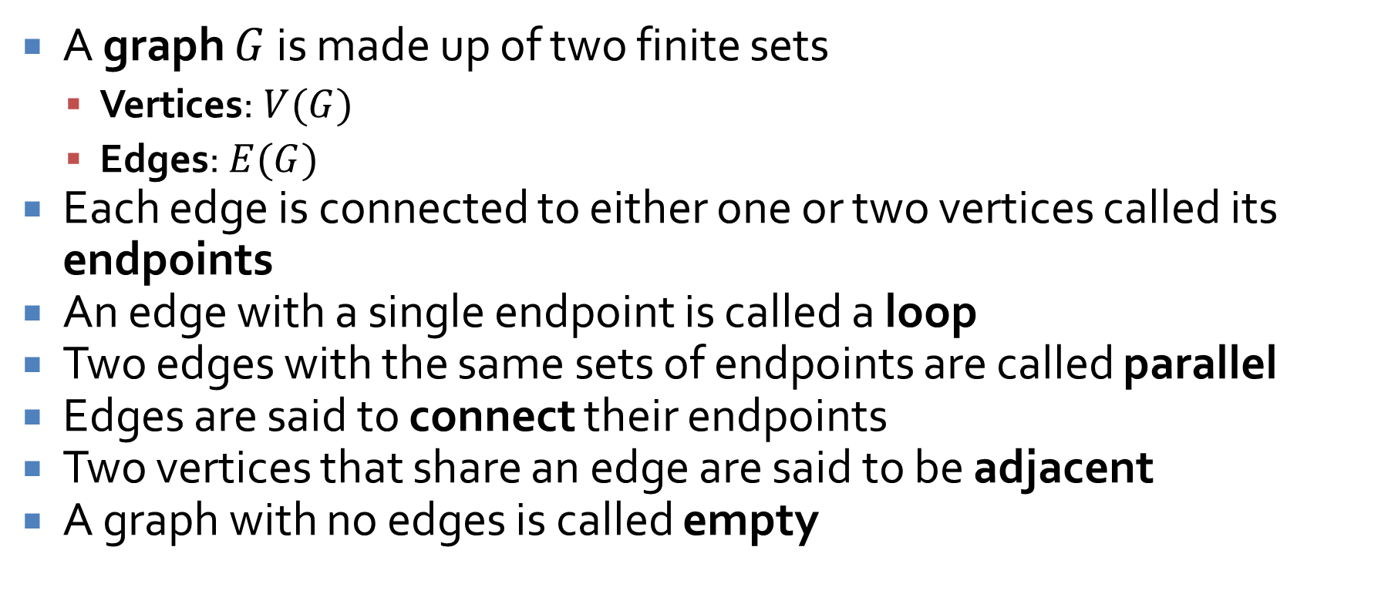
Graphs
A graph $G$ is made up of two finite sets
  Vertices: $V(G)$
  Edges: $E(G)$
Each edge is connected to either one or two vertices called its endpoints
An edge with a single endpoint is called a loop
Two edges with the same sets of endpoints are called parallel
Edges are said to connect their endpoints
Two vertices that share an edge are said to be adjacent
A graph with no edges is called empty

Slide 29
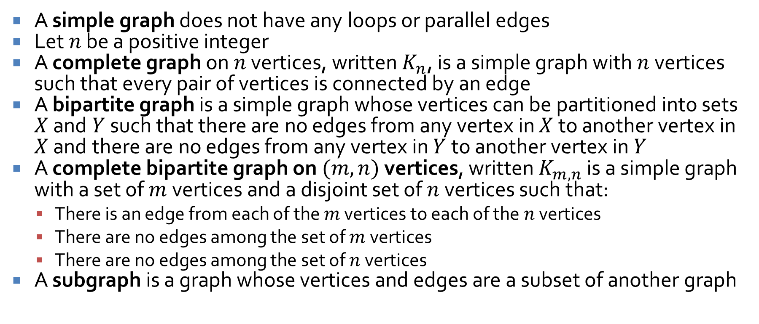
Special graphs
A simple graph does not have any loops or parallel edges
Let $n$ be a positive integer
A complete graph on $n$ vertices, written $K_{n}$, is a simple graph with $n$ vertices such that every pair of vertices is connected by an edge
A bipartite graph is a simple graph whose vertices can be partitioned into sets $X$ and $Y$ such that there are no edges from any vertex in $X$ to another vertex in $X$ and there are no edges from any vertex in $Y$ to another vertex in $Y$
A complete bipartite graph on $(m, n)$ vertices, written $K_{m,n}$ is a simple graph with a set of $m$ vertices and a disjoint set of $n$ vertices such that:
  There is an edge from each of the $m$ vertices to each of the $n$ vertices
  There are no edges among the set of $m$ vertices
  There are no edges among the set of $n$ vertices
A subgraph is a graph whose vertices and edges are a subset of another graph

Slide 30
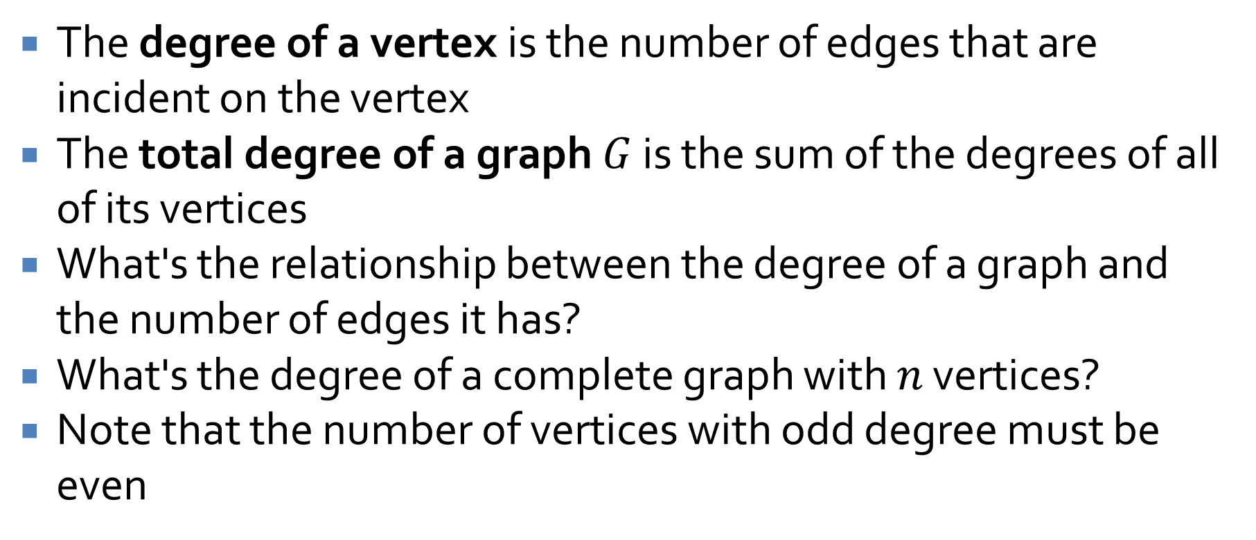
Degree
The degree of a vertex is the number of edges that are incident on the vertex
The total degree of a graph $G$ is the sum of the degrees of all of its vertices
What's the relationship between the degree of a graph and the number of edges it has?
What's the degree of a complete graph with $n$ vertices?
Note that the number of vertices with odd degree must be even

Slide 31

Example
What is the maximum number of edges a simple disconnected graph with $n$ vertices can have?
Prove it.

Slide 32
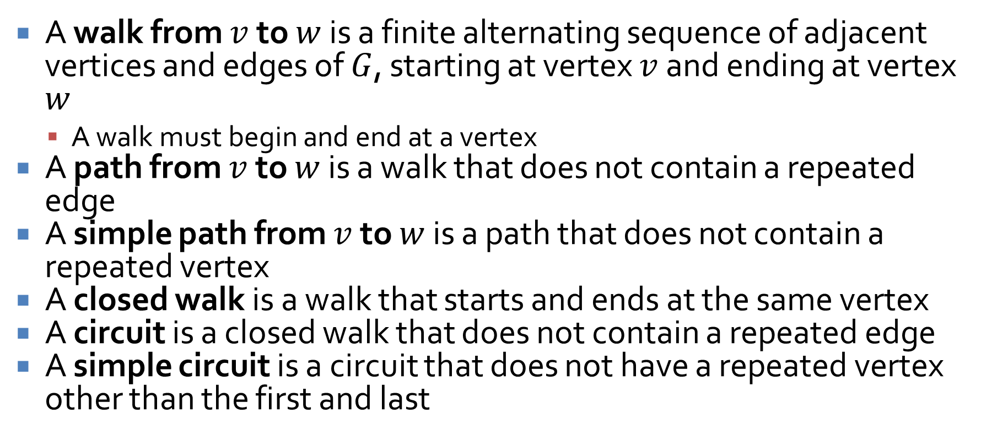
Definitions
A walk from $v$ to $w$ is a finite alternating sequence of adjacent vertices and edges of $G$, starting at vertex $v$ and ending at vertex $w$
  A walk must begin and end at a vertex
A path from $v$ to $w$ is a walk that does not contain a repeated edge
A simple path from $v$ to $w$ is a path that does not contain a repeated vertex
A closed walk is a walk that starts and ends at the same vertex
A circuit is a closed walk that does not contain a repeated edge
A simple circuit is a circuit that does not have a repeated vertex other than the first and last

Slide 33
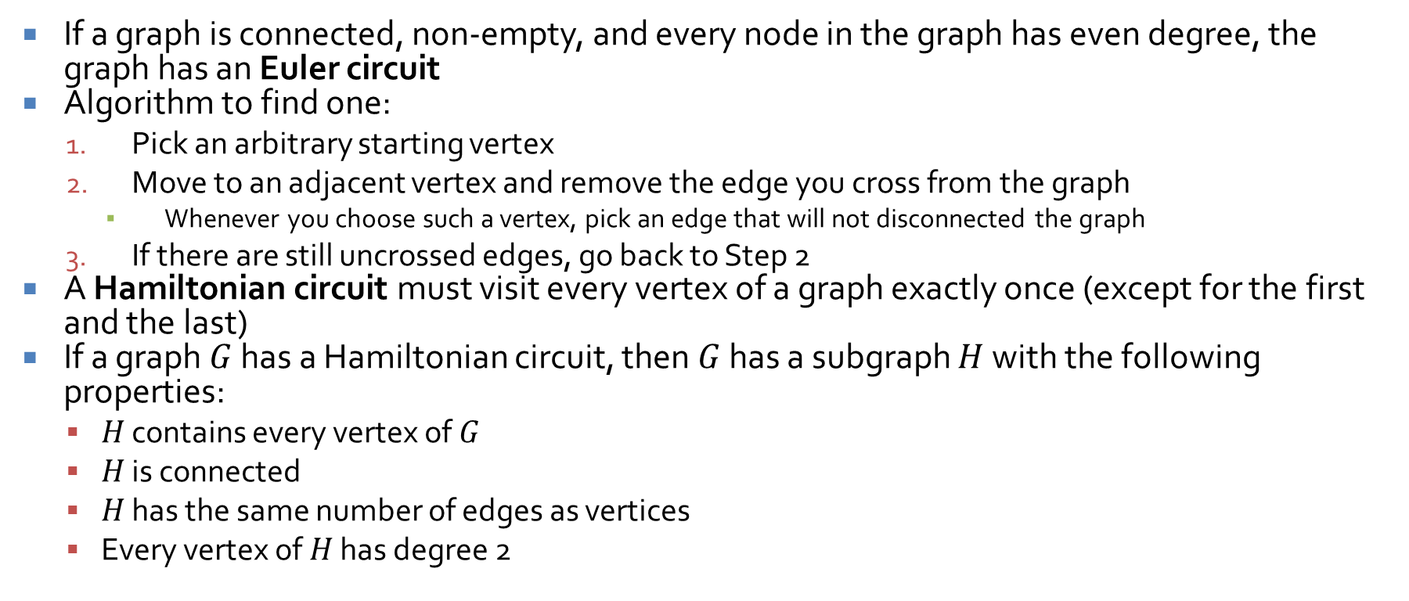
Circuits
If a graph is connected, non-empty, and every node in the graph has even degree, the graph has an Euler circuit
Algorithm to find one:
  Pick an arbitrary starting vertex
  Move to an adjacent vertex and remove the edge you cross from the graph
    Whenever you choose such a vertex, pick an edge that will not disconnected the graph
  If there are still uncrossed edges, go back to Step 2
A Hamiltonian circuit must visit every vertex of a graph exactly once (except for the first and the last)
If a graph $G$ has a Hamiltonian circuit, then $G$ has a subgraph $H$ with the following properties:
  $H$ contains every vertex of $G$
  $H$ is connected
  $H$ has the same number of edges as vertices
  Every vertex of $H$ has degree 2

Slide 34
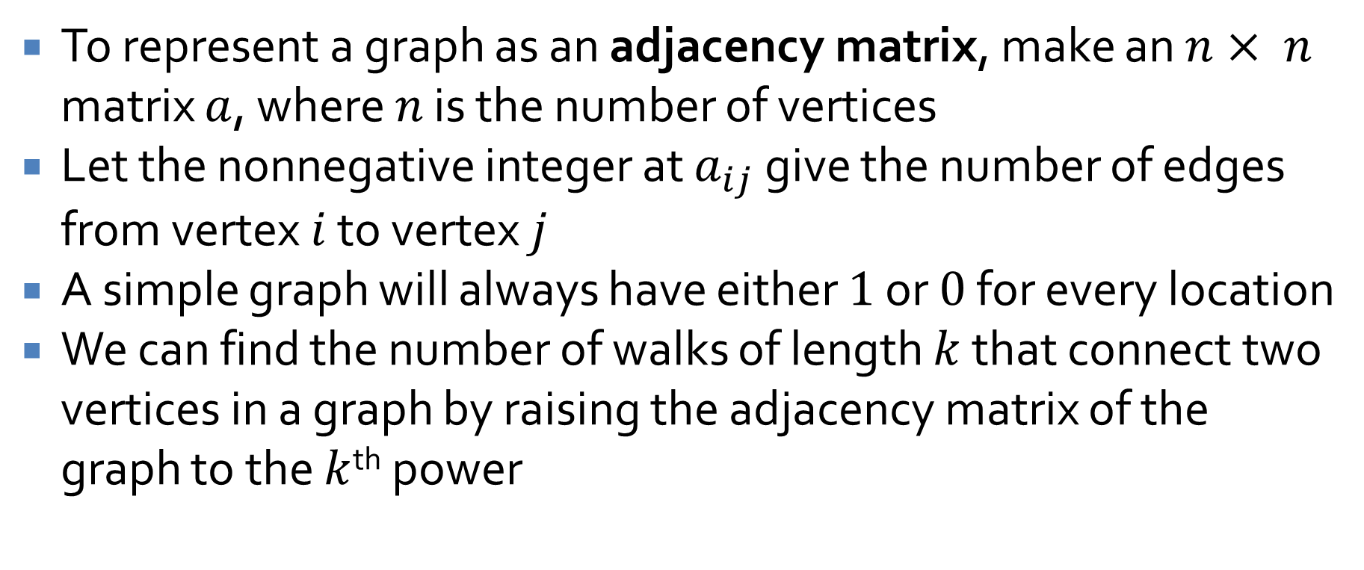
Matrix representations of graphs
To represent a graph as an adjacency matrix, make an $n× n$ matrix $a$, where $n$ is the number of vertices
Let the nonnegative integer at $a_{ij}$ give the number of edges from vertex $i$ to vertex $j$
A simple graph will always have either $1$ or $0$ for every location
We can find the number of walks of length $k$ that connect two vertices in a graph by raising the adjacency matrix of the graph to the $k$^{th} power

Slide 35
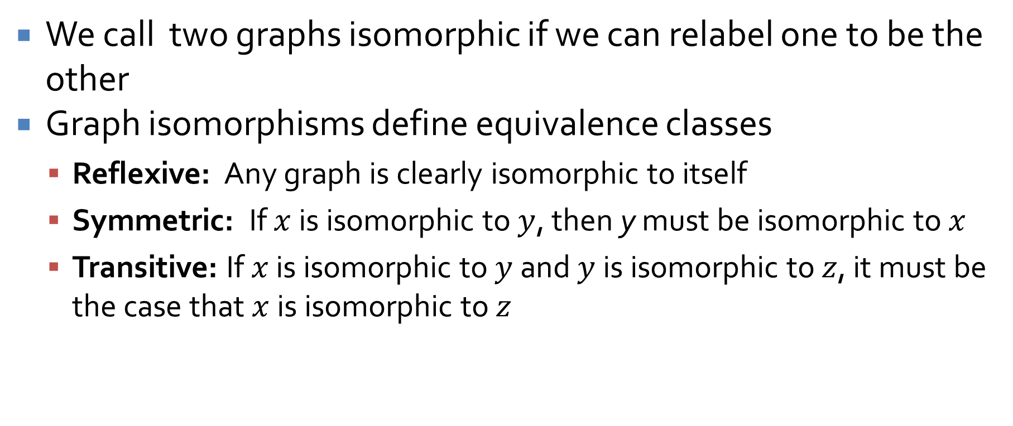
Isomorphism
We call two graphs isomorphic if we can relabel one to be the other
Graph isomorphisms define equivalence classes
  Reflexive: Any graph is clearly isomorphic to itself
  Symmetric: If $x$ is isomorphic to $y$, then y must be isomorphic to $x$
  Transitive: If $x$ is isomorphic to $y$ and $y$ is isomorphic to $z$, it must be the case that $x$ is isomorphic to $z$

Slide 36
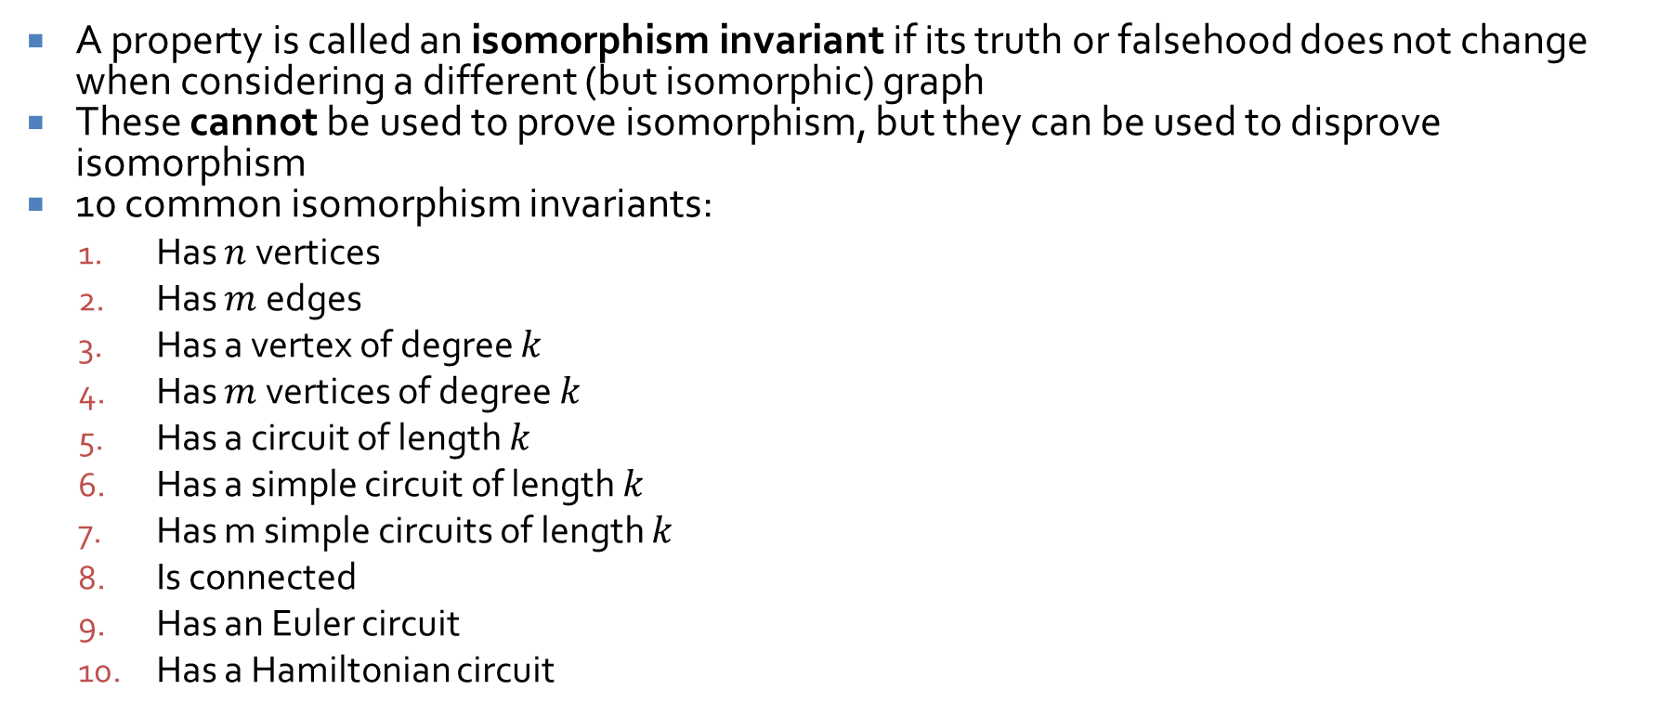
Isomorphism invariants
A property is called an isomorphism invariant if its truth or falsehood does not change when considering a different (but isomorphic) graph
These cannot be used to prove isomorphism, but they can be used to disprove isomorphism
10 common isomorphism invariants:
  Has $n$ vertices
  Has $m$ edges
  Has a vertex of degree $k$
  Has $m$ vertices of degree $k$
  Has a circuit of length $k$
  Has a simple circuit of length $k$
  Has m simple circuits of length $k$
  Is connected
  Has an Euler circuit
  Has a Hamiltonian circuit

Slide 37
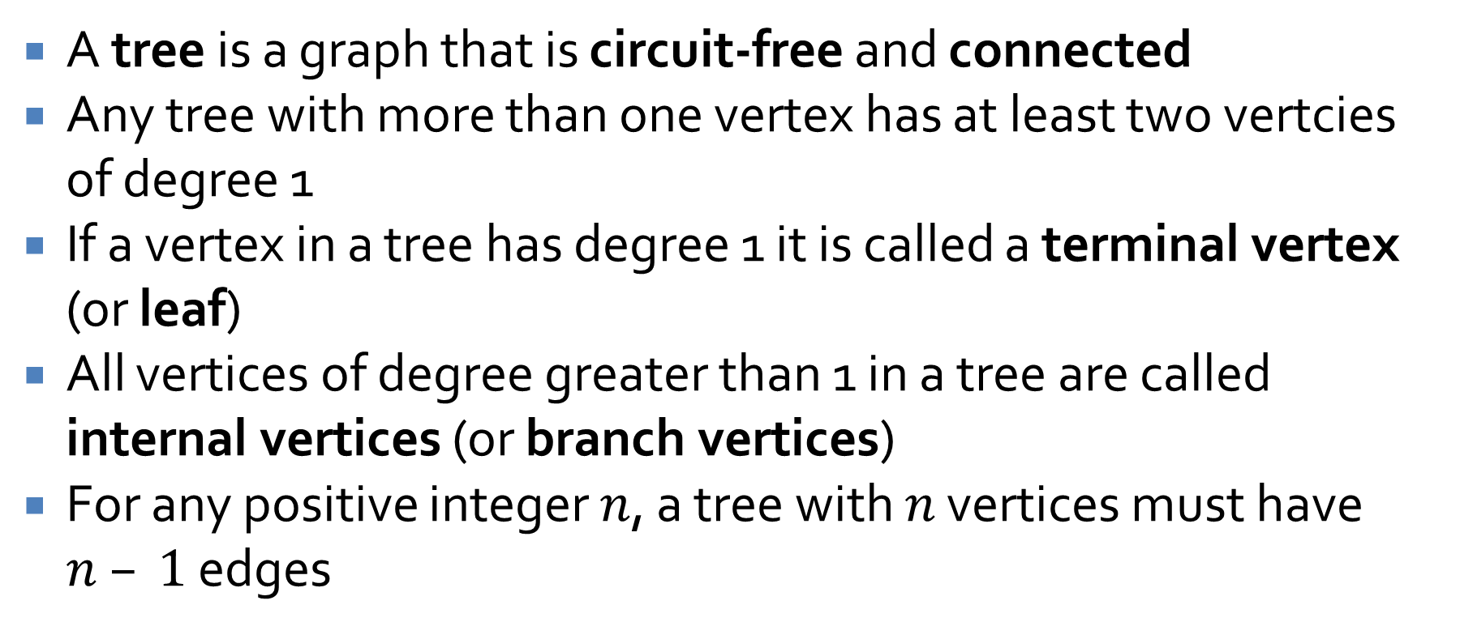
Trees
A tree is a graph that is circuit-free and connected
Any tree with more than one vertex has at least two vertcies of degree 1
If a vertex in a tree has degree 1 it is called a terminal vertex (or leaf)
All vertices of degree greater than 1 in a tree are called internal vertices (or branch vertices)
For any positive integer $n$, a tree with $n$ vertices must have $n – 1$ edges

Slide 38
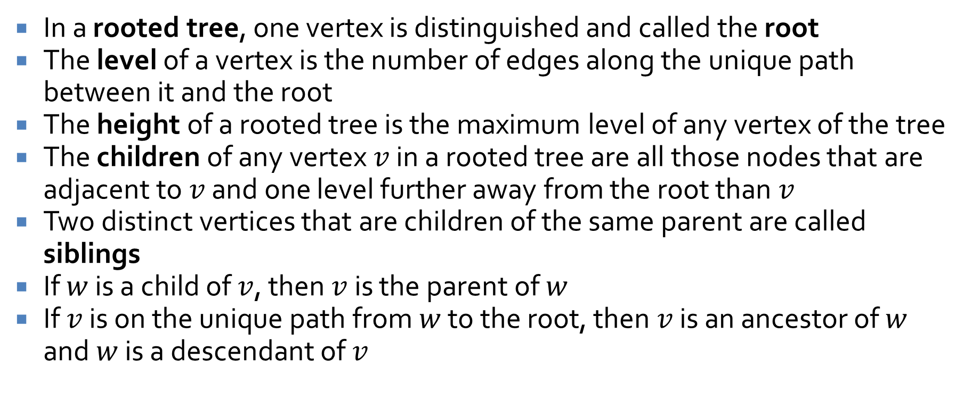
Rooted trees
In a rooted tree, one vertex is distinguished and called the root
The level of a vertex is the number of edges along the unique path between it and the root
The height of a rooted tree is the maximum level of any vertex of the tree
The children of any vertex $v$ in a rooted tree are all those nodes that are adjacent to $v$ and one level further away from the root than $v$
Two distinct vertices that are children of the same parent are called siblings
If $w$ is a child of $v$, then $v$ is the parent of $w$
If $v$ is on the unique path from $w$ to the root, then $v$ is an ancestor of $w$ and $w$ is a descendant of $v$

Slide 39
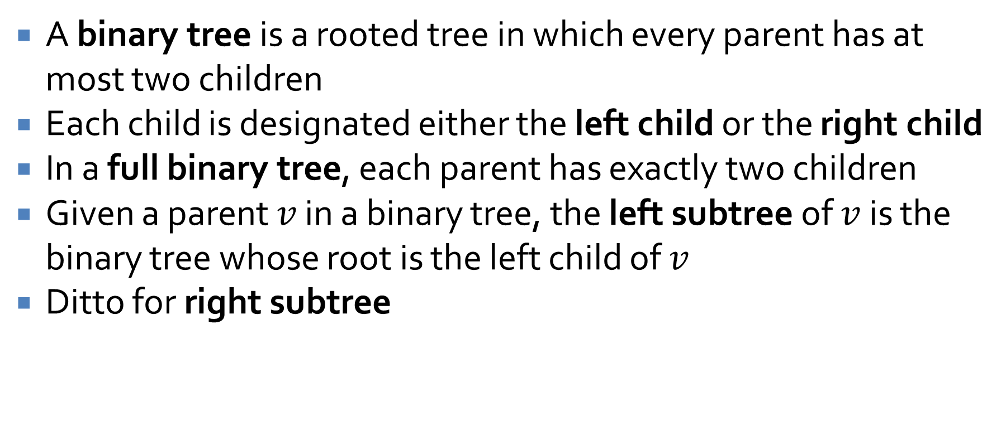
Binary trees
A binary tree is a rooted tree in which every parent has at most two children
Each child is designated either the left child or the right child
In a full binary tree, each parent has exactly two children
Given a parent $v$ in a binary tree, the left subtree of $v$ is the binary tree whose root is the left child of $v$
Ditto for right subtree

Slide 40
Spanning Trees

Slide 41
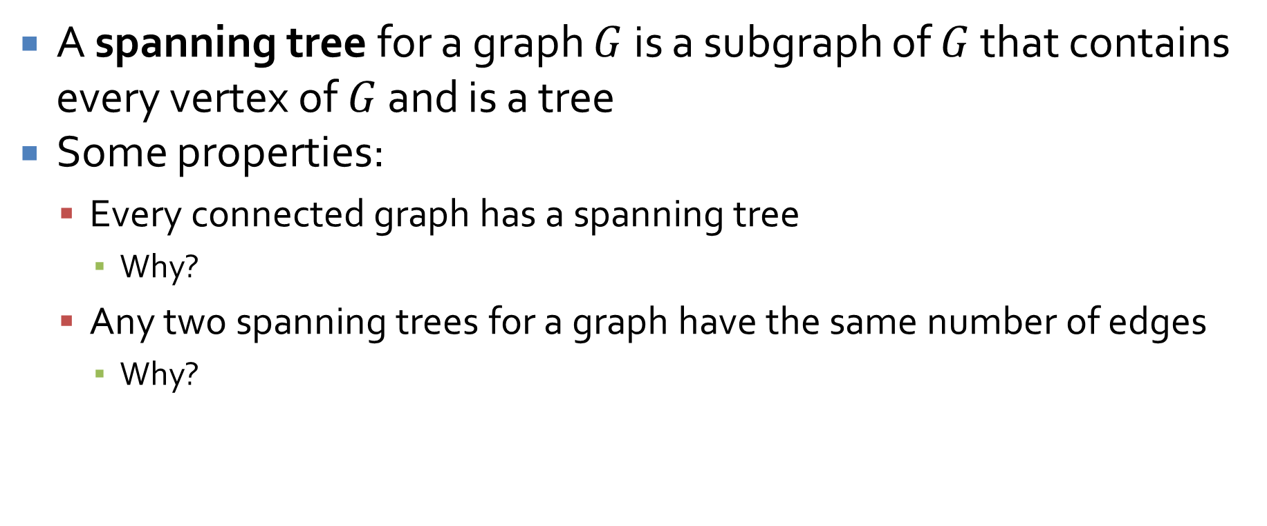
Spanning trees
A spanning tree for a graph $G$ is a subgraph of $G$ that contains every vertex of $G$ and is a tree
Some properties:
  Every connected graph has a spanning tree
    Why?
  Any two spanning trees for a graph have the same number of edges
    Why?

Slide 42
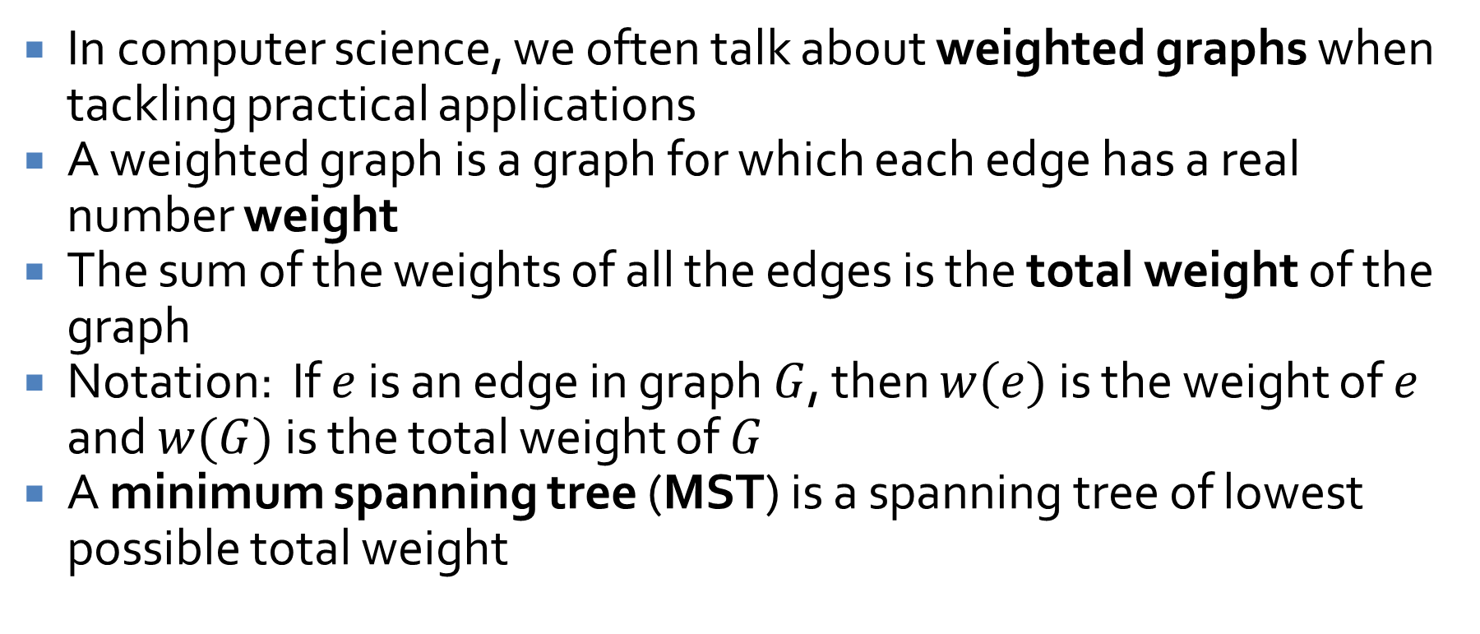
Weighted graphs
In computer science, we often talk about weighted graphs when tackling practical applications
A weighted graph is a graph for which each edge has a real number weight
The sum of the weights of all the edges is the total weight of the graph
Notation: If $e$ is an edge in graph $G$, then $w(e)$ is the weight of $e$ and $w(G)$ is the total weight of $G$
A minimum spanning tree (MST) is a spanning tree of lowest possible total weight

Slide 43
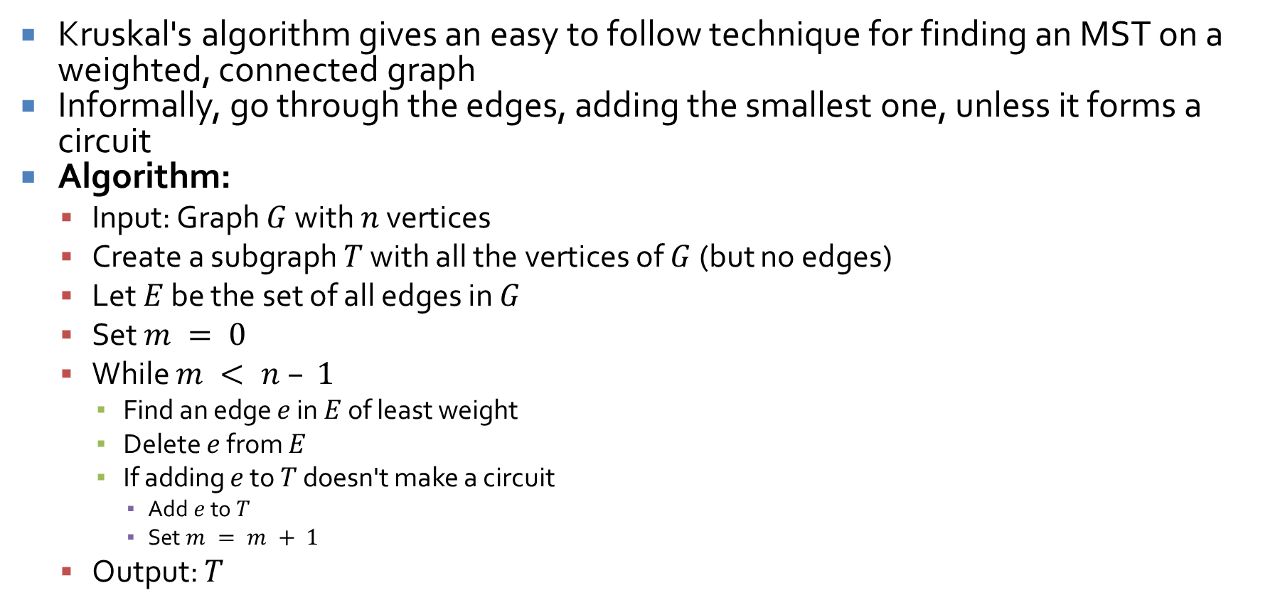
Finding a minimum spanning tree
Kruskal's algorithm gives an easy to follow technique for finding an MST on a weighted, connected graph
Informally, go through the edges, adding the smallest one, unless it forms a circuit
Algorithm:
  Input: Graph $G$ with $n$ vertices
  Create a subgraph $T$ with all the vertices of $G$ (but no edges)
  Let $E$ be the set of all edges in $G$
  Set $m = 0$
  While $m < n – 1$
    Find an edge $e$ in $E$ of least weight
    Delete $e$ from $E$
    If adding $e$ to $T$ doesn't make a circuit
      Add $e$ to $T$
      Set $m = m + 1$
  Output: $T$

Slide 44
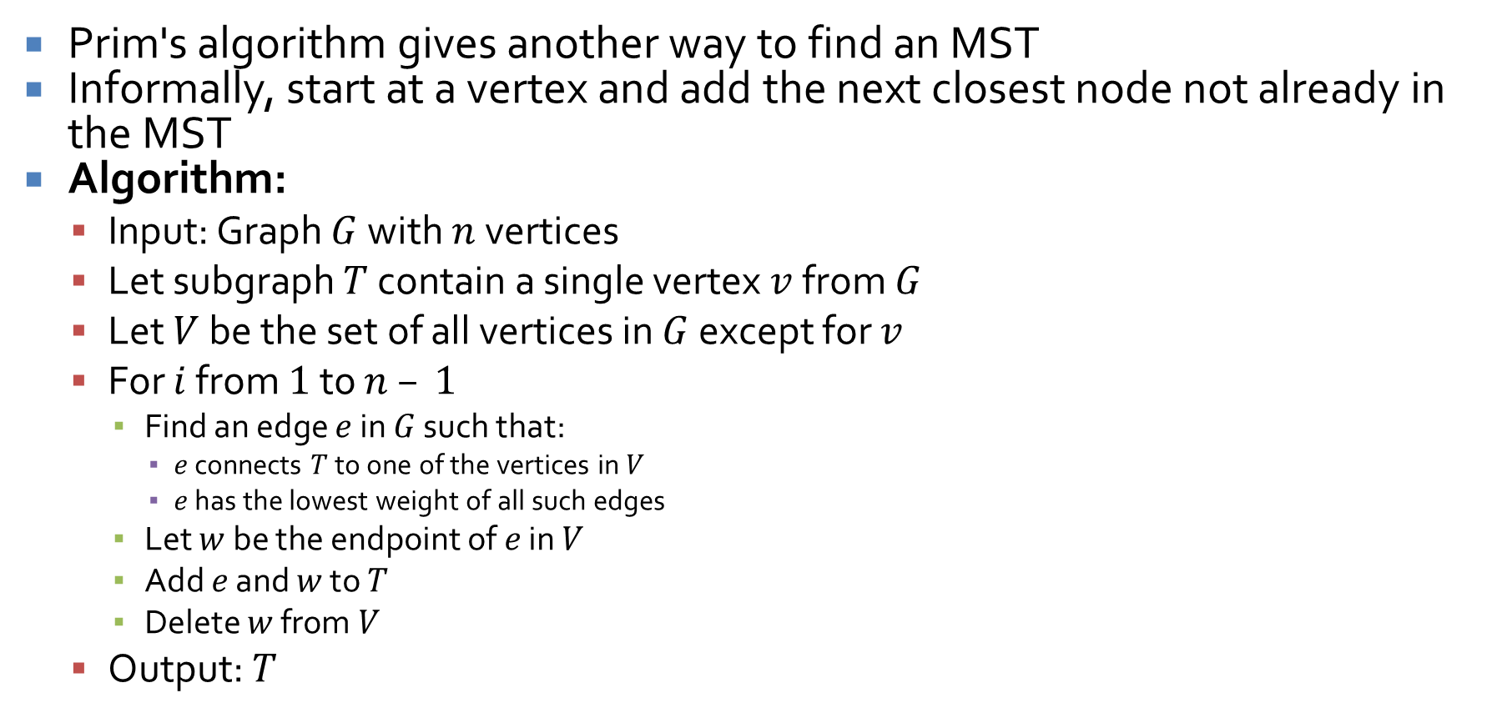
Prim's algorithm
Prim's algorithm gives another way to find an MST
Informally, start at a vertex and add the next closest node not already in the MST
Algorithm:
  Input: Graph $G$ with $n$ vertices
  Let subgraph $T$ contain a single vertex $v$ from $G$
  Let $V$ be the set of all vertices in $G$ except for $v$
  For $i$ from $1$ to $n – 1$
    Find an edge $e$ in $G$ such that:
      $e$ connects $T$ to one of the vertices in $V$
      $e$ has the lowest weight of all such edges
    Let $w$ be the endpoint of $e$ in $V$
    Add $e$ and $w$ to $T$
    Delete $w$ from $V$
  Output: $T$

Slide 45
Growth of Functions

Slide 46
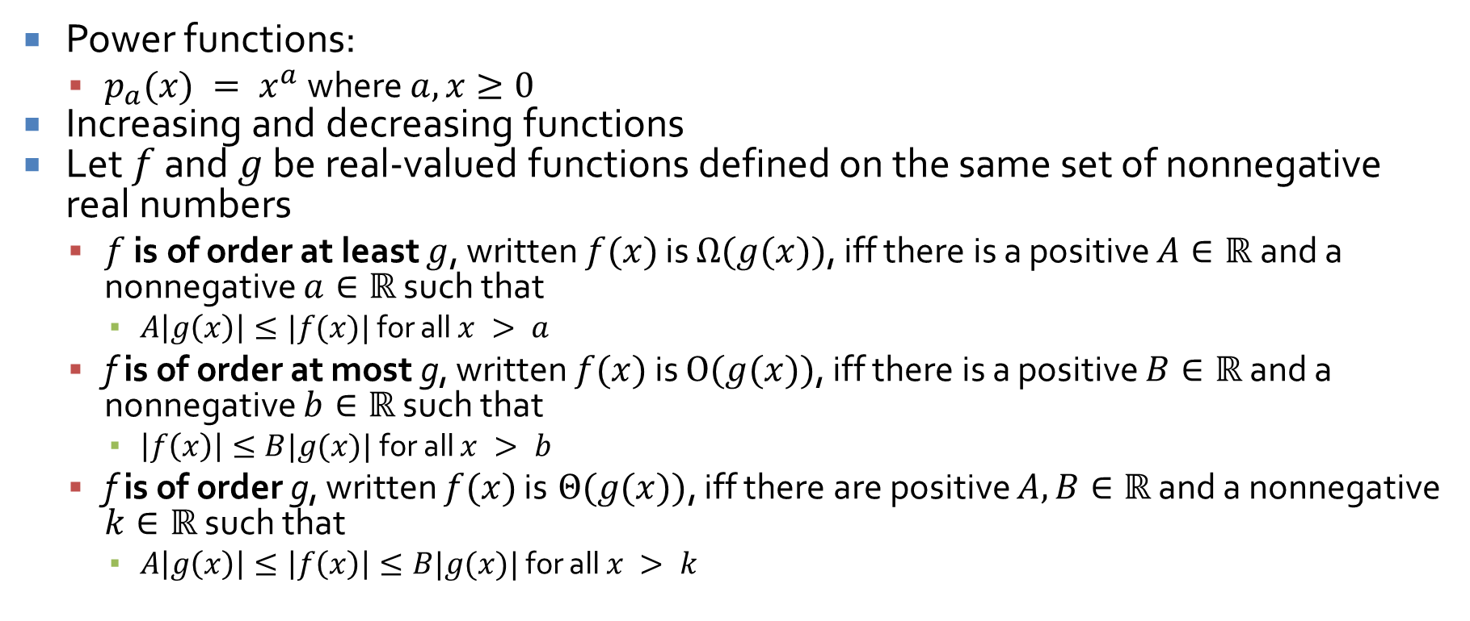
Growth of functions
Power functions:
  $p_{a}(x) = x^{a}$ where $a,x≥0$
Increasing and decreasing functions
Let $f$ and $g$ be real-valued functions defined on the same set of nonnegative real numbers
  $f$ is of order at least $g$, written $f(x)$ is $Ω(g(x))$, iff there is a positive $A∈ℝ$and a nonnegative $a∈ℝ$ such that
    $A\left|g\left(x\right)\right|≤|f(x)|$ for all $x > a$
  f is of order at most g, written $f(x)$ is $O(g(x))$, iff there is a positive $B∈ℝ$ and a nonnegative $b∈ℝ$ such that
    $\left|f\left(x\right)\right|≤B|g(x)|$for all $x > b$
  f is of order g, written $f(x)$ is $Θ(g(x))$, iff there are positive $A, B∈ℝ$ and a nonnegative $k∈ℝ$ such that
    $A\left|g\left(x\right)\right|≤\left|f\left(x\right)\right|≤B|g(x)|$ for all $x > k$

Slide 47
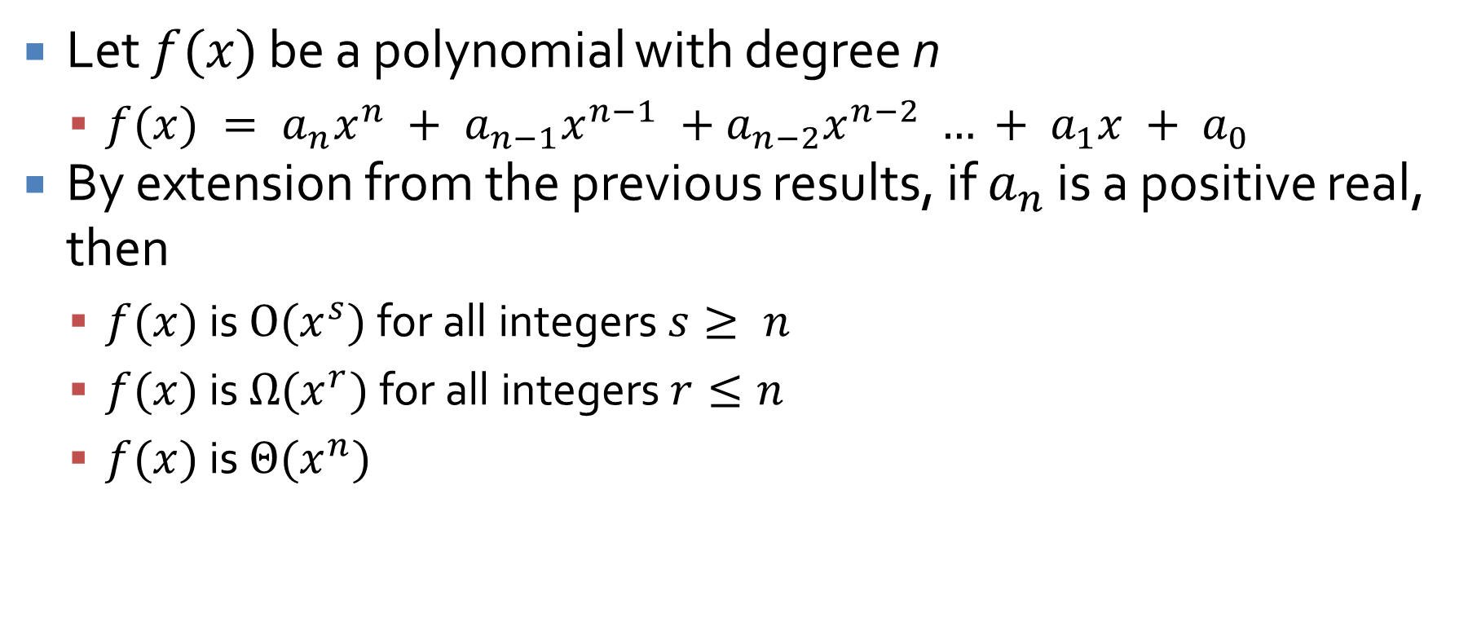
Polynomials
Let $f(x)$ be a polynomial with degree n
  $f(x) = a_{n}x^{n} + a_{n−1}x^{n−1} +a_{n−2}x^{n−2} … + a_{1}x + a_{0}$
By extension from the previous results, if $a_{n}$ is a positive real, then
  $f(x)$ is $O(x^{s})$ for all integers $s≥ n$
  $f(x)$ is $Ω(x^{r})$ for all integers $r≤n$
  $f(x)$ is $Θ(x^{n})$

Slide 48
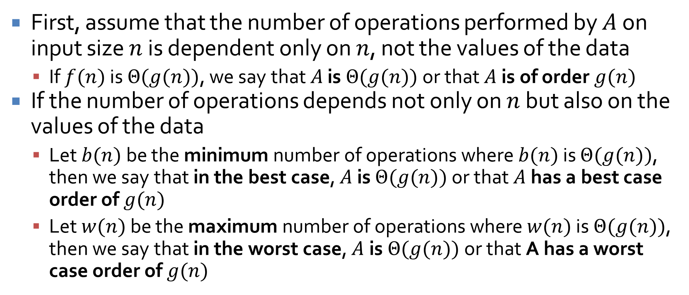
Running time for algorithms
First, assume that the number of operations performed by $A$ on input size $n$ is dependent only on $n$, not the values of the data
  If $f(n)$ is $Θ(g(n))$, we say that $A$ is $Θ(g(n))$ or that $A$ is of order $g(n)$
If the number of operations depends not only on $n$ but also on the values of the data
  Let $b(n)$ be the minimum number of operations where $b(n)$ is $Θ(g(n))$, then we say that in the best case, $A$ is $Θ(g(n))$ or that $A$ has a best case order of $g(n)$
  Let $w(n)$ be the maximum number of operations where $w(n)$ is $Θ(g(n))$, then we say that in the worst case, $A$is $Θ(g(n))$ or that A has a worst case order of $g(n)$

Slide 49
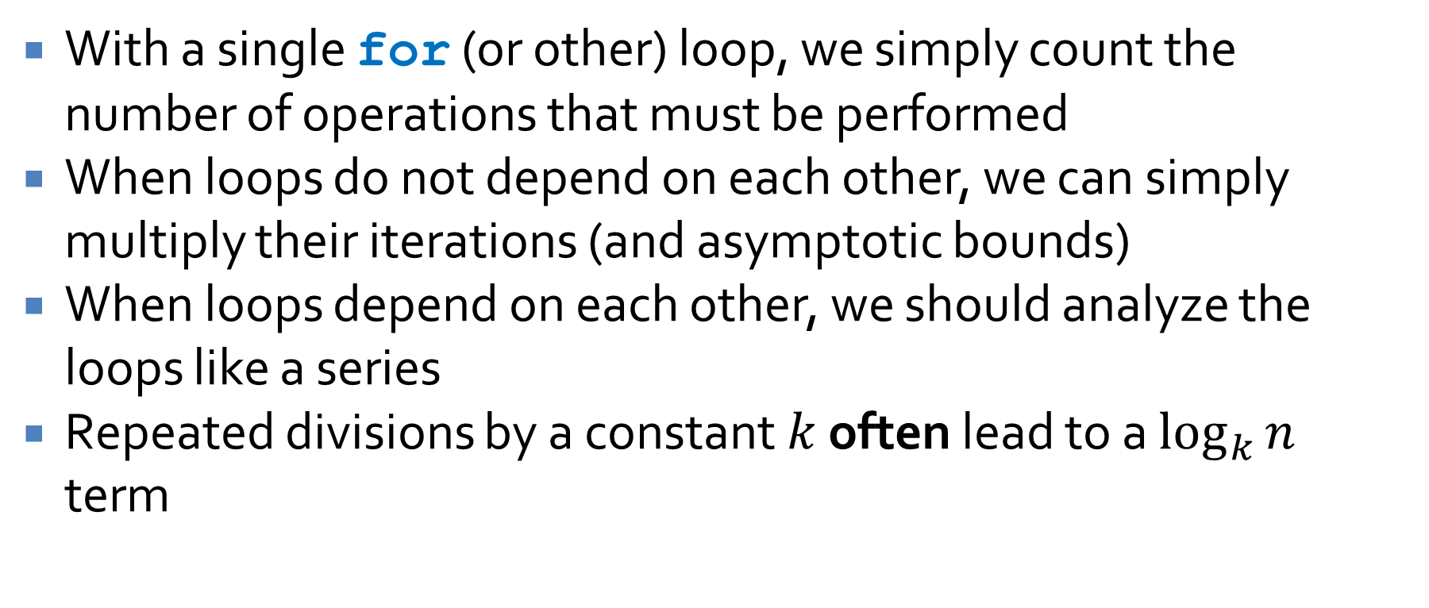
Computing running time
With a single for (or other) loop, we simply count the number of operations that must be performed
When loops do not depend on each other, we can simply multiply their iterations (and asymptotic bounds)
When loops depend on each other, we should analyze the loops like a series
Repeated divisions by a constant $k$ often lead to a $\log_{k}{n}$ term

Slide 50
Upcoming

Slide 51
Next time…
Exam 3

Slide 52
Reminders
Finish Assignment 5
Study for Exam 3 on Monday

